Slide 1
Data format
Load generated synthetic model and reformat the data
Class (24000,) 0 9
vp (100, 240) 1500.0 6839.872834598128
vs (100, 240) 0.0 3593.8244297758774
dn (100, 240) 1000.0 2953.6736203709856
vpvs (100, 240) 1.6846551790318647 INF
qp (100, 240) 21.287755021839683 1000.0
qs (100, 240) 5.745752745694737 1000.0
Aggregated shape: (24000, 7)

Slide 2
Data preprocessing
There are no NaNs but there are INF values in Vp/Vs
Replaces INF with -9999
uses this value since there are high values in Vp/Vs (max at 2.259288e+08)
Tried replacing INF with max float value but yields worse mapping
Normalize
norm_data = (norm_data – mean) / std
mean and std value are stored so that the model can normalize new data in the save way

Slide 3
SOMs implementation
Uses MiniSom
https://github.com/JustGlowing/minisom
Iris map
MNIST map

Slide 4
Hyperparameters tuning
SOMs Kohonen layer’s dimension
Number of Iterations
Learning rate
Sigma (neighborhood function)
Uses Gridsearch and Randomsearch to find best parameters

Slide 5
Gridsearch
ideal SOMs dimension = sqrt( 5 * sqrt(num_sample))
num_sample = 24000
in this case, ideal dimension = 27
dims = [-5, 0, 5, 10] + ideal_dim = [22, 27, 32, 35]
iter_cnts = [2000, 4000, 5000, 6000]
lr = [0.25, 0.5, 0.75]
sigma = [1, 2, 2.5, 3, 4]

Slide 6
Randomsearch
assigning random value in a range for each hyperparameter
dim = [30, 35]
iter_cnt = [4000, 5000] with step size of 200
learning_rate = [0.5, 0.75]
sigma =[2, 2.5]

Slide 7
Best Hyperparameters
dim = 34
iter_cnt = 4000
learning_rate = 0.5124390316684666
sigma = 2.189655172413793

Slide 8
Training / Testing process
X_train, X_test, y_train, y_test = train_test_split(norm_data, label, random_state=seed)
split original dataset into train and test set
test_size = 0.25 (6,000)
train size = 0.75 (18,000)

Slide 9
Best SOMs result
Best acc found: 97.67%
train 97.65%
test 97.56%

Slide 10
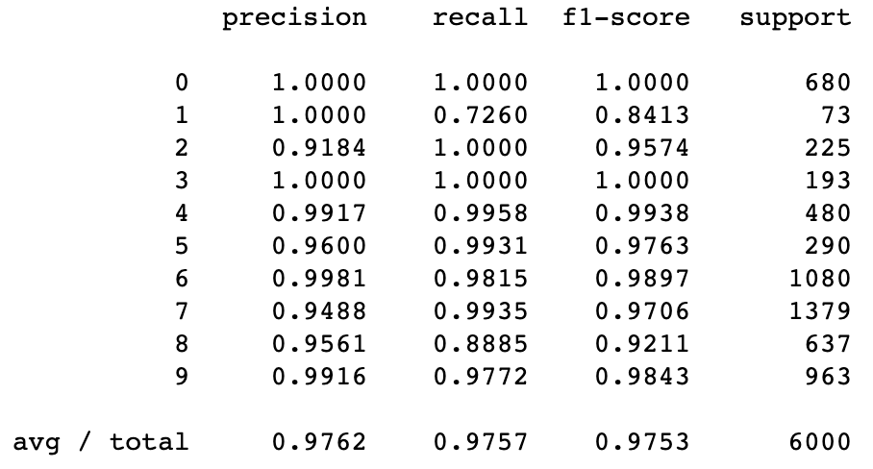
Result Analysis
class 1 (Siltstone) sample seem to be too small

